Slide 1
Bitcoin NFTs & Ordinal Protocols
By: Rana Ahsan Ansar

Slide 2
Introduction to Ordinals Protocol
BTC Ordinals were introduced as a method of generating Bitcoin NFTs by attaching information to individual satoshi.
Ordinal inscriptions are digital assets, similar to NFTs, inscribed on a satoshi in the Bitcoin network. All this data in minted on blockchain. This process has been made possible because of Taproot soft fork launched on November 14, 2021. Ordinal protocol allows the tracking and transfer of individual satoshis using ordinal wallet.
Ordinals Protocol is a system, In which each satoshi is linked by a serial number, it allow users to make individual satoshi unique by attaching extra data to them. This process is known as “Inscription”.

Slide 3
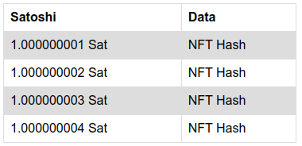
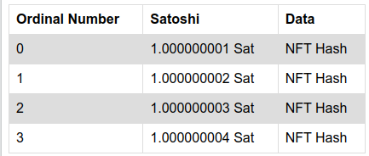
Explaination dy giving an example
Amuse that we have a table without serial number represent data coming from node
After applying ordinal protocol each satoshi is represent by a unique primary key.

Slide 4
Representations of Ordinal Numbers
Ordinal numbers have a few different representations:
Integer notation: 2099994106992659 The ordinal number, assigned according to the order in which the satoshi was mined.
Decimal notation: 3891094.16797 The first number is the block height in which the satoshi was mined, the second the offset of the satoshi within the block.
Degree notation: 3°111094′214″16797‴. We'll get to that in a moment
Percentile notation: 99.99971949060254% . The satoshi’s position in Bitcoin's supply, expressed as a percentage.
Name: satoshi. An encoding of the ordinal number using the characters a through z.

Slide 5
Methods to create Ordinal inscriptions
By using Ordinal-compatible wallets or online services. For example: Ordinals Wallet, Unisat wallet and Gama service.
By running a full node and ord server in your system.

Slide 6
Steps for creating ordinal inscription using BTC full node
Install bitcoin core.
Sync the Bitcoin node with main net.
Install ord server.
Sync the Ord server with Bitcoin node.
Create bitcoin ordinal wallet
Create your Inscriptions using cli command.

Slide 7
Installation of Bitcoin node
There are two method to run a bitcoin node in to your system.
Using Bitcoin Core (User interface Client)
Using HomeBrew tool. (Command Line interface)
Brew is used to install and start bitcoin node. It automatically install all the required dependencies.

Slide 8


Step for Installing Bitcoin using Brew
Install Homebrew by using command available on http://brew.sh
Install bitcoin using “brew install bitcoin”
Start bitcoin node using “brew services start bitcoin”
Check Node is running or not using bitcoin-cli getblockcount

Slide 9
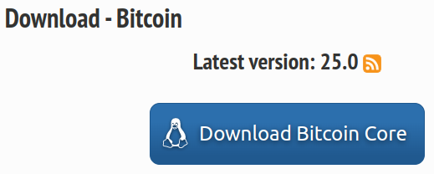
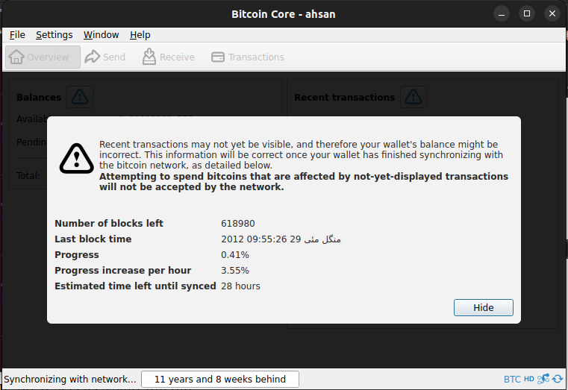
Step for Installing Bitcoin Core (Client)
Go to the https://bitcoincore.org/en/download/
Install latest version.
Run the Bitcoin core client.

Slide 10
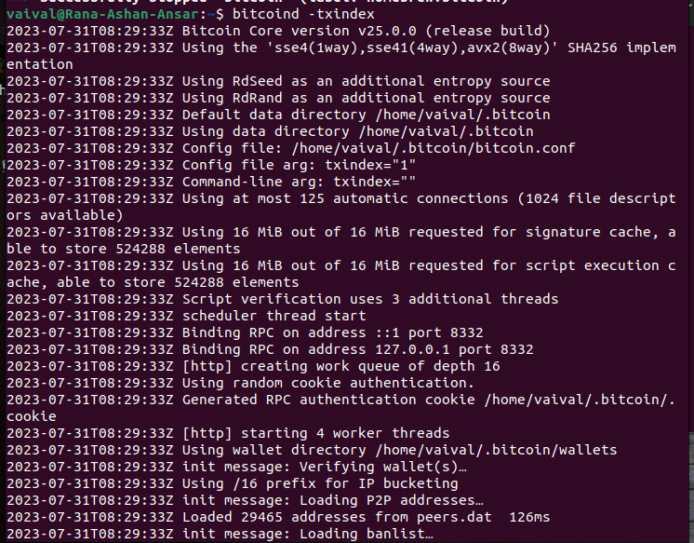
Sync the node with Ord indexes
ord requires Bitcoin Core's transaction index.
To configure your Bitcoin Core node to maintain a transaction index, run this command “ bitcoind -txindex ”

Slide 11

Next steps after running and syncing Bitcoin
Install cargo with rust
Install ord using cargo “ cargo install ord ”
Now, run the ord server after running full node using “ord server”

Slide 12
Continue
Create Bitcoin core wallet using “ord wallet create”
Send some satoshis in ord wallet.
Create Inscriptions using
“ord wallet inscribe --fee-rate FEE_RATE FILE”

Slide 13
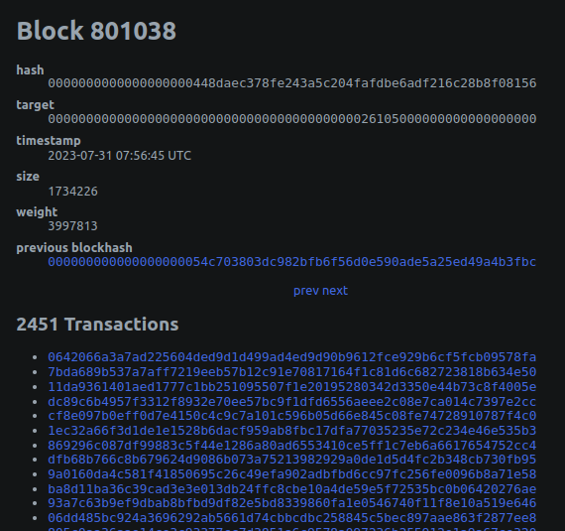
Ordinal Explorer
Now you can track you inscription using Ordinal Block explorer

Slide 14
BRC-20
The minting process for BRC-20 and BRC-721 is same but the concepts behind these tokens are different.
BRC-20 tokens utilize Ordinals inscriptions of JSON file data to deploy token contracts, mint, and transfer tokens. Currently, the BRC-20 token standard allows creating a BRC-20 token with the deploy function, minting an amount of BRC-20 tokens with the mint function, and transferring an amount of BRC-20 tokens via the transfer function.
The BRC-20 token standard is new and the process of deploying, minting, and transferring BRC-20 tokens isn't user-friendly. There are also a limited number of tooling and supporting services.

Slide 15

BRC-20 Examples
Here is example of JSON file for minting a BRC-20 token.
The Key “p” represent the token standard brc-20.
The key “op” represent operations (mint, deploy, transfer)
The key “tick” represent the name of token.
The key “amt” represent the amount of tokens.

